Slide 1
EDA ON Airways_customer_data
Sharmi J

Slide 2
Data set
1.Kaggle – Airways_customer_data
This dataset contains information about the British Airways Customer Data in almost 69 unique countries across the world. The data were gathered by scraping from (https://www.airlinequality.com/).
2. Size of data – (3418, 5)
3. Names of columns -
'Unnamed: 0', 'reviews', 'rates', 'date', 'country'.

Slide 3
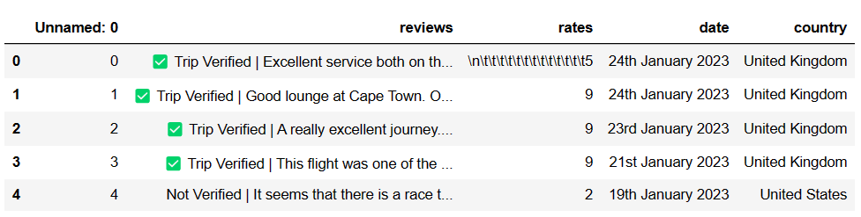
INCLUDING LIBRARIES AND READING DATASET
import pandas as pd
import numpy as np
import os
import matplotlib.pyplot as plt
import seaborn as sns
import plotly.express as px
import datetime as dt
Reading CSV file

Slide 4

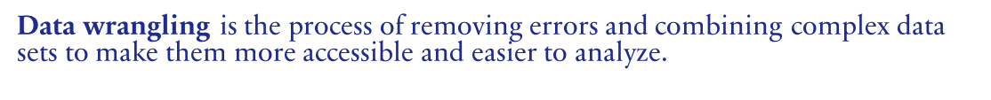
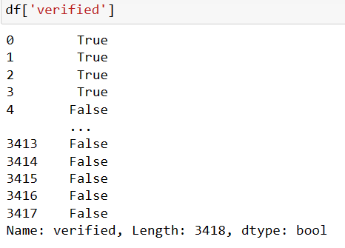

1.Understanding Size Of Data
2. Checking columns and datatypes of each column.

Slide 5
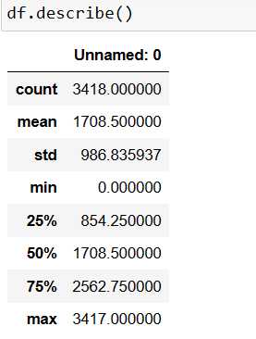
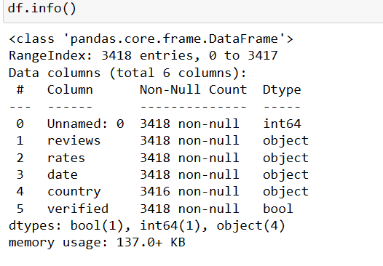

Slide 6
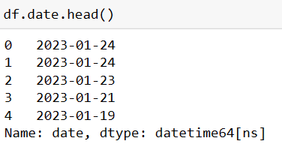
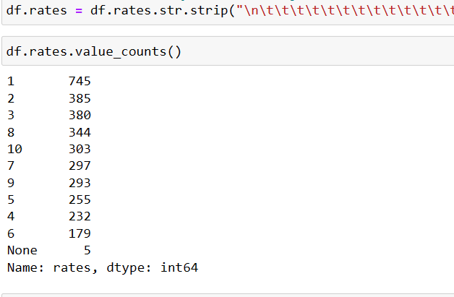
Data Cleaning
Data cleaning is the process of fixing or removing incorrect, corrupted, incorrectly formatted, duplicate, or incomplete
data within a dataset.
1. Cleaning Format Date
2.Cleaning Ratings with Stars

Slide 7
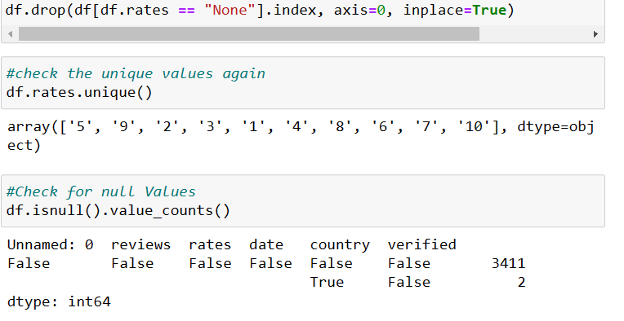
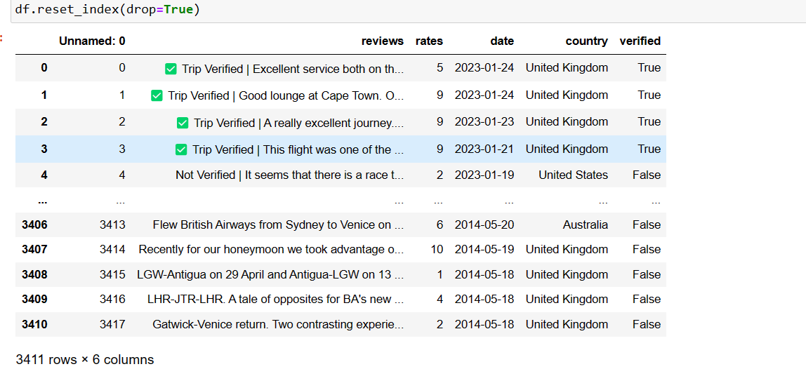
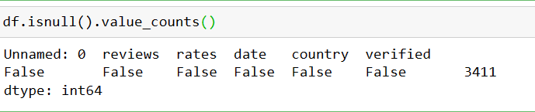
3.Drop the rows where the value of ratings is None
4.Resetting the index

Slide 8
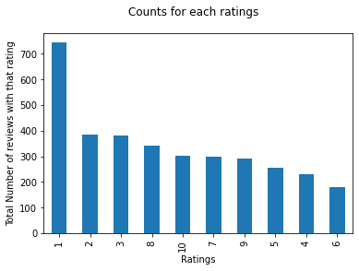
Data Visualization
Data visualization is the graphical representation of information and data. By using visual elements like charts, graphs, and
maps, data visualization tools provide an accessible way to see and understand trends, outliers, and patterns in data.
1.Counts For Each Ratings
df.rates.value_counts().plot(kind="bar")
plt.xlabel("Ratings")
plt.ylabel("Total Number of reviews with that rating")
plt.suptitle("Counts for each ratings")

Slide 9
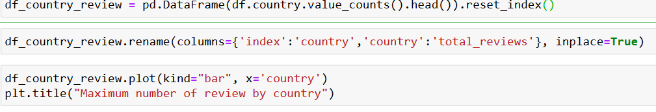
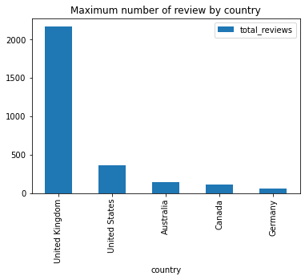
2.Maximum Number of Review by Country

Slide 10
SUMMARY
CSV containing British Airways Customer data information for 69 unique countries across the world.
We Analyse the average overall rating for British Airways.
After that we find the total count for each ratings.
Then Analyse the maximum number of review by country.
Finally we did find the United Kingdom provided on average highest ratings.

Slide 11
THANK YOU

